Slide 1

Distributed Systems Security Ordering, Broadcast, Synchronization & Fault Tolerance Case Study: Apache Kafka
Yousef ahmed salama
231004873

Slide 2

Distributed Systems Overview
A distributed system is a collection of independent nodes that communicate over a network
Nodes coordinate to appear as a single unified system
Key Characteristics:
Concurrency (multiple nodes operate simultaneously)
No global clock
Independent failures possible
Main Challenges:
Maintaining consistency across nodes
Handling failures and delays
Ensuring secure communication

Slide 3
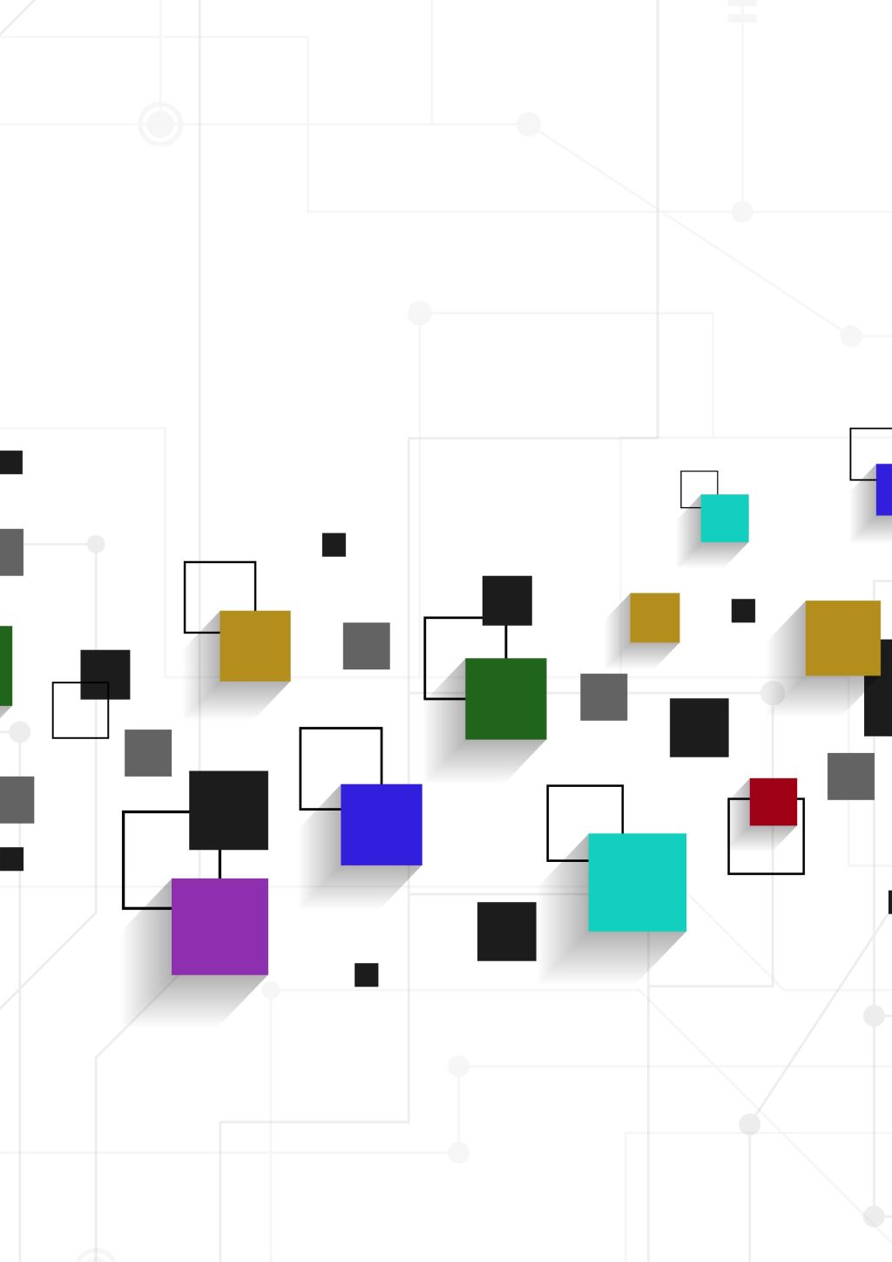
What is Apache Kafka?
A distributed event streaming platform
Designed for high-throughput, real-time data processing
Core Components:
Producer → sends messages
Broker → stores and manages data
Consumer → reads messages
Topic → category of messages
Partition → enables parallelism
Key Features:
Horizontal scalability
Fault tolerance via replication
Persistent storage

Slide 4
┌───────────────┐
│ PRODUCER │
└───────┬───────┘
│
▼
┌────────────────────────────────┐
│ KAFKA CLUSTER │
│ ┌──────────┐ ┌──────────┐ │
│ │ Broker 1 │ │ Broker 2 │ │
│ │ Topic A │ │ Topic A │ │
│ │ Part 0 │ │ Part 1 │ │
│ └──────────┘ └──────────┘ │
└───────────────┬────────────────┘
│
┌───────────────┼───────────────┐
▼ ▼ ▼
┌────────────┐ ┌────────────┐ ┌────────────┐
│ Consumer 1 │ │ Consumer 2 │ │ Consumer 3 │
└────────────┘ └────────────┘ └────────────┘

Slide 5

Message Ordering
Ordering defines how messages are delivered and processed across nodes
Types of Ordering:
FIFO → per sender order
Causal → preserves dependencies
Total → same order for all nodes
Kafka Implementation:
Guarantees FIFO ordering within each partition
No ordering across multiple partitions
👉 Design Trade-off:
✔ High performance & scalability
✘ No global consistency

Slide 6
┌──────────────────────────────┐
│ PARTITION 0 │
│ M1 → M2 → M3 → M4 → M5 │
│ ✔ Strict FIFO Ordering │
└──────────────────────────────┘
┌──────────────────────────────┐
│ PARTITION 1 │
│ M1 → M3 → M2 → M5 → M4 │
│ ✘ No Global Ordering │
└──────────────────────────────┘
RESULT:
✔ Order guaranteed INSIDE partition
✘ Order NOT guaranteed BETWEEN partitions

Slide 7
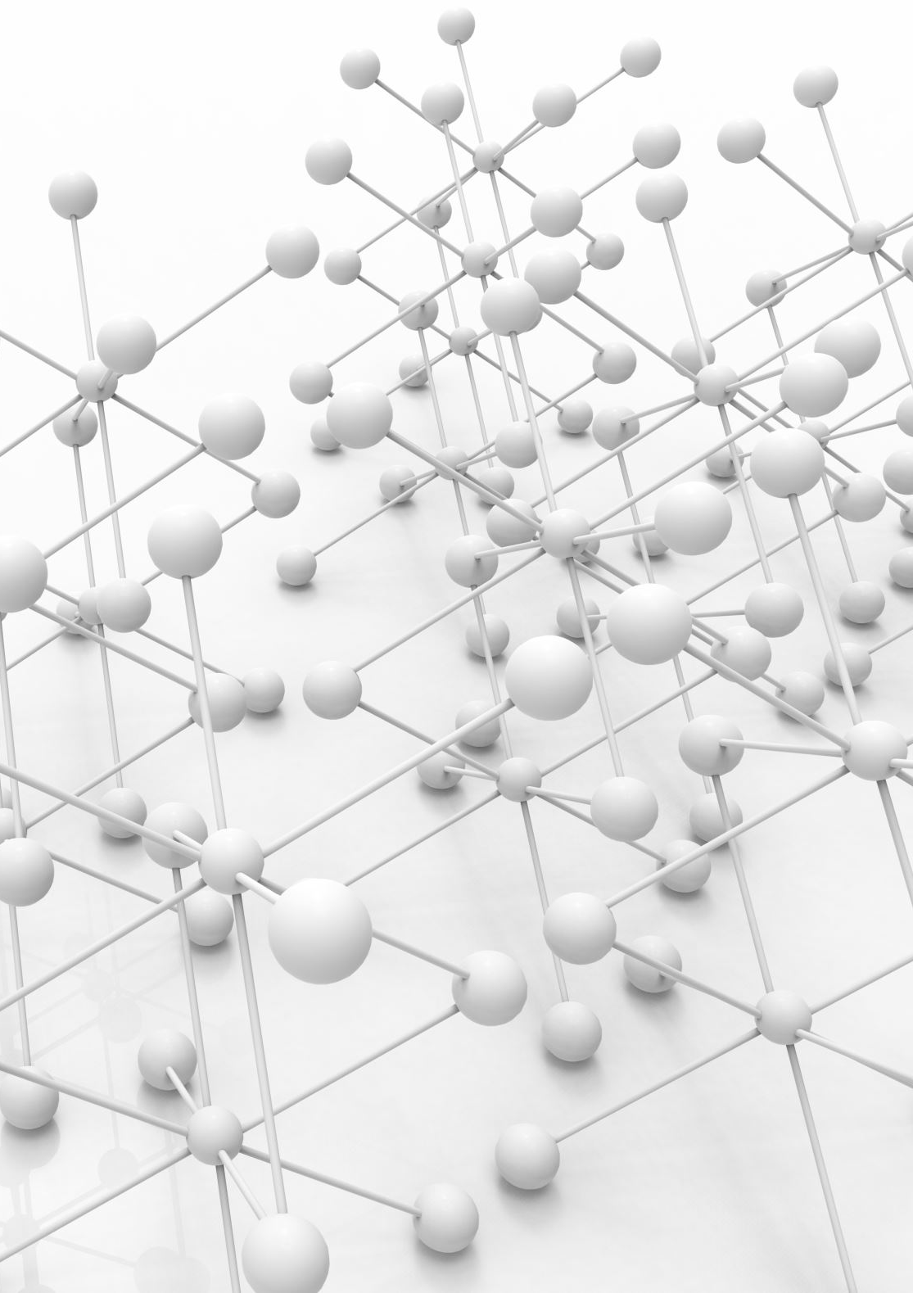
Broadcast Model
Broadcast = sending messages from one node to many nodes
Types:
Best-effort → no guarantees
Reliable → ensures delivery
Atomic → delivery + total ordering
Kafka Model:
Uses Publish–Subscribe architecture
Producers → publish to topics
Consumers → subscribe
👉 Similar to Reliable Broadcast
Messages are replicated across brokers
Ensures durability and availability

Slide 8
┌───────────────┐
│ PRODUCER │
└───────┬───────┘
│
▼
┌───────────────┐
│ TOPIC │
│ (Kafka Bus) │
└───────┬───────┘
┌───────────────────┼───────────────────┐
▼ ▼ ▼
┌──────────────┐ ┌──────────────┐ ┌──────────────┐
│ CONSUMER A │ │ CONSUMER B │ │ CONSUMER C │
└──────────────┘ └──────────────┘ └──────────────┘
✔ One-to-many communication
✔ Decoupled system (no direct links)

Slide 9
Broadcast in Synchronous vs Asynchronous Systems
Broadcast behavior depends on the system’s timing model.
Synchronous Broadcast:
Message delivery time is bounded
All nodes receive messages within a known time
Failures are detected quickly
✔ Enables strong guarantees (Reliable / Atomic Broadcast) ✔ Deterministic behavior
✘ Not realistic in large-scale systems
Asynchronous Broadcast:
No guarantees on message delivery time
Messages may be delayed indefinitely
Hard to distinguish failure from delay
✔ Realistic and scalable ✔ Flexible system design
✘ Harder to guarantee ordering and reliability

Slide 10
Kafka’s Model:
Apache Kafka operates in a partially asynchronous system
Uses replication + acknowledgments
Broadcast is reliable but NOT time-bounded
👉 Designed for scalability, not strict timing guarantees

Slide 11
Sender
│
├──[ 1 sec ]──► Node A
├──[ 1 sec ]──► Node B
└──[ 1 sec ]──► Node C
✔ Fixed delay
✔ Predictable delivery
✔ Strong guarantees

Slide 12
Sender
│
├──[ ? ]──► Node A
├──[ ? ]──► Node B
└──[ ? ]──► Node C
✔ Unknown delay
✔ Messages may arrive anytime
✔ Real-world scalable systems

Slide 13
Byzantine Fault Tolerance
Handles nodes that behave maliciously or incorrectly
Based on: Byzantine Generals Problem
Problem:
Nodes may send false or conflicting information
Solution Requirement:
Need 3f + 1 nodes to tolerate f malicious nodes
Kafka:
✔ Handles crash failures
✘ Does NOT handle Byzantine (malicious) faults

Slide 14
Fault tolerance ensures the system continues operating despite failures.
Kafka achieves fault tolerance using replication:
Each partition is replicated across multiple brokers
One broker acts as the leader, others are followers
👉 Replication Factor (RF):
RF = number of copies of data
👉 Fault Tolerance Rule:
System can tolerate f failures where:
f = RF - 1
Example:
RF = 3 → system tolerates 2 broker failures
👉 How it works:
If leader fails → a follower is elected as new leader
Data remains available due to replication
✔ Handles crash failures ✘ Does NOT handle Byzantine (malicious) failures

Slide 15
┌───────────────────┐
│ LEADER BROKER │
│ (Partition 0) │
└─────────┬─────────┘
│
┌─────────────────┼─────────────────┐
▼ ▼ ▼
┌──────────────┐ ┌──────────────┐ ┌──────────────┐
│ FOLLOWER 1 │ │ FOLLOWER 2 │ │ FOLLOWER 3 │
│ Replica │ │ Replica │ │ Replica │
└──────────────┘ └──────────────┘ └──────────────┘
Replication Factor = 3
✔ Data copied across brokers
✔ If leader fails → follower replaces it
✔ No data loss (if replicas in sync)

Slide 16
Protocols in Kafka
Kafka uses a leader–follower replication protocol
Process:
Producer sends message to leader broker
Leader writes to log
Followers replicate data
Acknowledgment is sent
Related Concepts:
Raft
Paxos
👉 Ensures:
Data consistency
Fault tolerance

Slide 17

System Scale & Number of Servers
In distributed systems, the number of servers depends on system scale, workload, and fault tolerance requirements.
For Apache Kafka deployments:
Small-scale systems:
3–5 brokers
Used for testing or small applications
Medium-scale systems:
10–50 brokers
Handles moderate traffic and real-time processing
Large-scale systems:
100+ brokers
Used by enterprises handling massive data streams
👉 Key Factors Affecting Server Count:
Data throughput (messages per second)
Number of partitions
Replication factor
Fault tolerance requirements
👉 Design Insight: Kafka scales horizontally by adding more brokers, allowing the system to handle increasing load efficiently

Slide 18

Leader Election in Kafka
Kafka uses a leader–follower model for managing partitions.
👉 Leader Election Process:
Each partition has one leader broker
Producers and consumers communicate only with the leader
If the leader fails:
A new leader is selected from the followers
👉 Coordination Mechanisms:
Older Kafka:
Uses ZooKeeper for leader election and cluster coordination
Modern Kafka:
Uses KRaft (Kafka Raft Metadata Mode)
Removes dependency on ZooKeeper
Based on Raft consensus algorithm
👉 Key Benefits:
Ensures availability
Maintains consistency
Enables automatic recovery from failures

Slide 19
BEFORE FAILURE
┌───────────────┐
│ LEADER │
└──────┬────────┘
│
┌──────▼──────┐
│ FOLLOWER │
└──────┬──────┘
│
┌──────▼──────┐
│ FOLLOWER │
└─────────────┘
AFTER FAILURE
✘ Leader crashes
┌───────────────┐
│ NEW LEADER │ ◄── elected
└──────┬────────┘
│
┌──────▼──────┐
│ FOLLOWER │
└─────────────┘

Slide 20
Replicated State Machine (RSM) in Kafka
A Replicated State Machine (RSM) ensures all nodes maintain the same state by applying the same sequence of operations.
👉 In Kafka:
Each partition acts as a log (sequence of events)
Logs represent the system state
Messages are appended in order
👉 Replication Mechanism:
Leader writes data to log
Followers replicate the same log
All replicas stay consistent
👉 Why Kafka behaves like an RSM:
Same ordered log → same state across nodes
Ensures consistency and fault tolerance
👉 Benefits:
Strong data consistency
Fault recovery using replicated logs
Deterministic state across brokers

Slide 21
LEADER LOG
[ M1 → M2 → M3 → M4 → M5 ]
│
▼
┌───────────────────────────┐
│ FOLLOWERS │
│ [ M1 → M2 → M3 → M4 → M5 ]│
└───────────────────────────┘
✔ Same log sequence
✔ Same system state
✔ Strong consistency across nodes

Slide 22

Advantages & Disadvantages
Advantages:
High throughput (handles large data streams)
Scalable (partition-based design)
Fault tolerant (replication mechanism)
Durable storage
Disadvantages:
No global message ordering
Not Byzantine fault tolerant
Requires careful configuration
Can be complex to manage

Slide 23
Conclusion
Distributed systems require:
Reliable communication
Consistent ordering
Fault tolerance
Apache Kafka provides:
Efficient data streaming
Strong scalability
👉 Trade-off:
Performance vs strong consistency & security

Slide 24
THANK YOU

